Slide 1
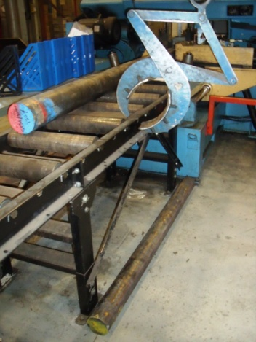
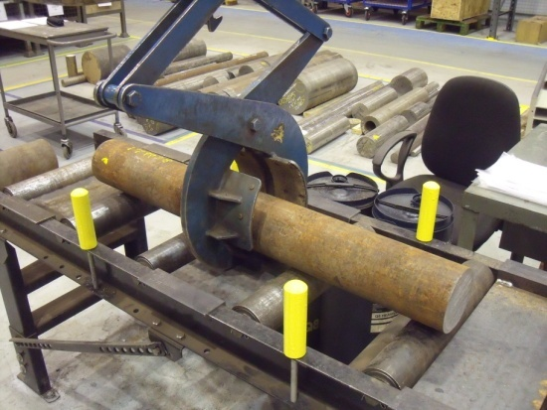
HS&E INCIDENT BULLETIN |  | 2nd Quarter 2012
Type of Incident: | Fracture
Summary: | Before After
IP was loading a 105mm dia 1.55m bar onto the stores saw which rolled off striking the IP across his left foot fracturing his middle metatarsal.
Root Causes: | Actions Taken Thus Far: Next Steps
Equipment -Faulty/inadequate design | SOP now established & all operators re-trained Side rail pegs and activation plates implemented
BEFORE

